Slide 1
Methods Section
Priscilla Samayoa

Slide 2

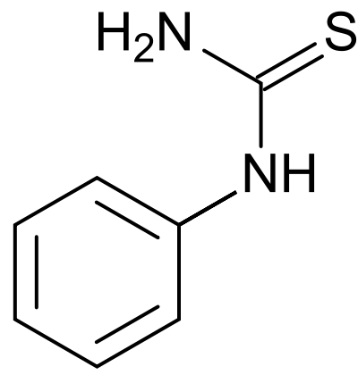
Tasting cups
Phenylthiocarbamide

Slide 3
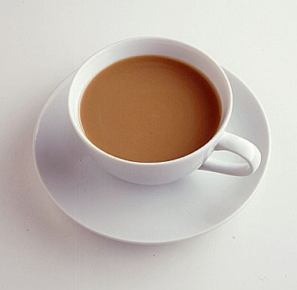


Three samples of coffee

Slide 4
Subjects were asked to taste three different concentrations of PTC, rinsing mouth between all samples.
Subjects then rated the bitterness on a scale of 1-5 (5 being the most bitter) on tables provided.
Subjects then tasted coffee samples and repeated the steps for PTC on bitterness and favor.

Slide 5
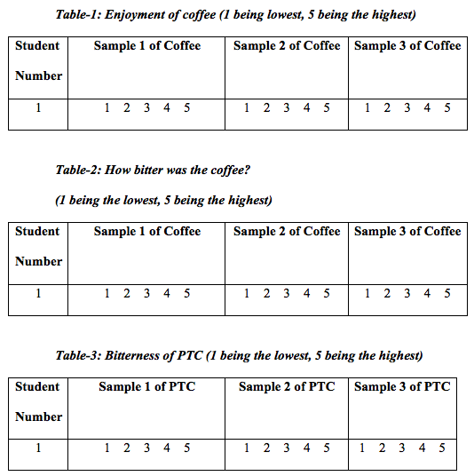
Tables

Slide 6
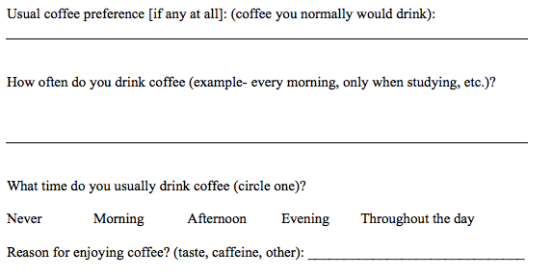
Additional Questionare

